Slide 1
Federated services accessible through the 'PaN portal‘ Alun Ashton, PSI
2nd November 2020

Slide 2

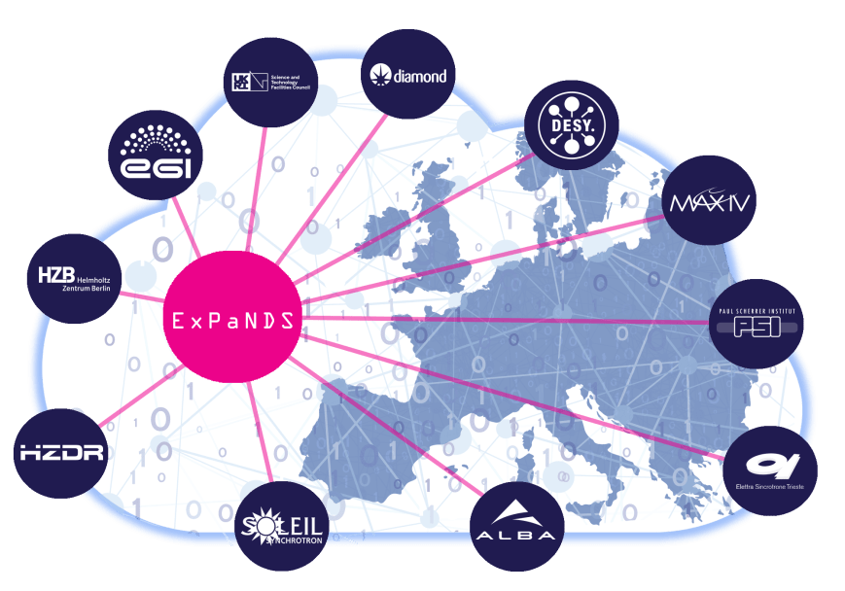
How do PaN facilities work?
User: has an idea / need to study a sample
Proposal: User writes a proposal for one or more of the PaN facilities
Review : Proposals reviewed for feasibility and scientific quality
Experiment time allocated: User travels to facility / sends sample
Experiment: Sample(s) are exposed to beam + data collected
Analysis: Data is reduced, analysed + curated (DOI)
Publication: User publishes results (DOI) in peer review journal

Slide 3
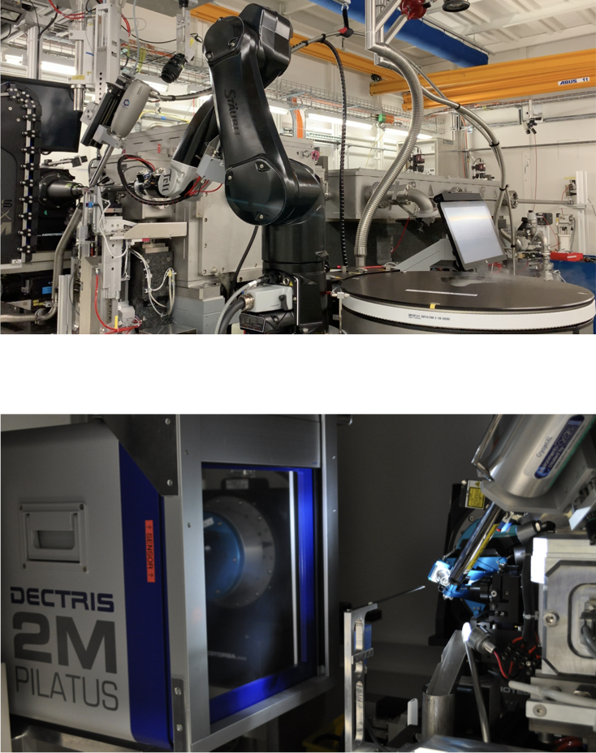
Typical PaN Facility Infrastructure
Cold Storage
Instruments
Export
UDP
ACQ Server(s)
NFS Export
Archive and Catalogue
(On premise or CLOUD)
DAQ Servers
NFS/SMB Export
(Shared)
Offline
Storage
Local/Shared Instruments Storage
Login nodes
Compute Nodes (CPU/GPU)
Dedicated Compute Nodes

Slide 4
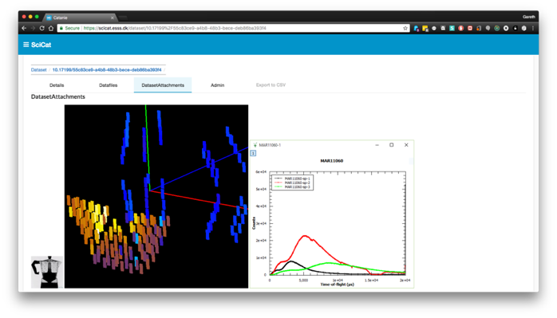



Data Catalogues – Common Functions
Catalogues are an entry point to other EOSC services, often provided by the facilities, like Download, Processing, Analysis or Visualisation Services.
Store reference to raw data and the relevant metadata to identify interesting dataset to work with.
Information available often includes:
Proposal Information
Sample Information
Experimental Parameters
Previews
Provenance
Relationship to derived datasets
Relationship to people
Catalogues also Facilitate Data Re-Use, Sharing and Publication via PIDs and DOIs.

Slide 5

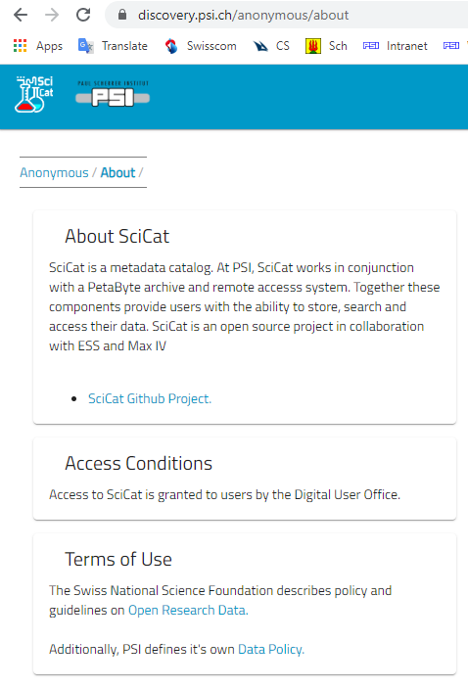
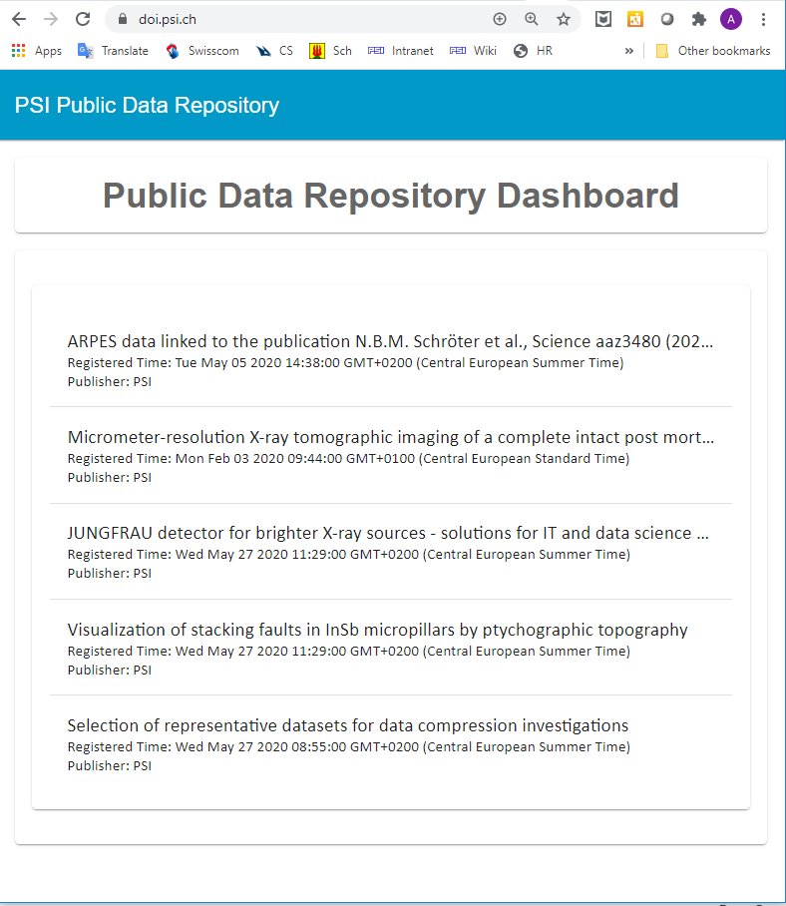
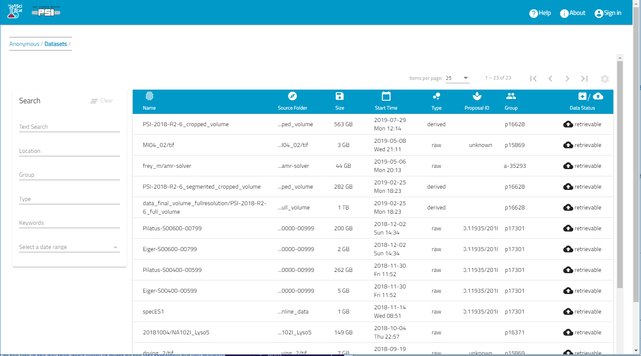
Petabyte archive and Data Catologue discovery.psi.ch

Slide 6

PaN Data Lifecycle
Process
Store Data
Validate Data
Visualize Data
Create
Experiment
Measurements
Collect Metadata
Analysis
Integrate Data
Create Output
Publish Results
Plan
Data formats
Storage
Sources
Metadata
Papers
Papers
Papers
Proposal
Save
Curate,
Store and Archive
Metadata &
Data
Reuse
Impact Research
Reviews
Teaching
Access
Share Data
Open Access
Access rules and
control

Slide 7



Two Routes for Opening Datasets as Federated Services
 | Harvesting | Custom Search
Exposure Method | Push Metadata resides in third party EOSC repository | Pull Metadata stays at facility
Time to Market | Quick (existing solution) | Duration of PaNOSC
Data under embargo | Cannot be exposed | After Authentication
Richness of Metadata | Common Schema (Dublin Core initially) | Domain Specific Metadata
Target User Group | Citizen Scientists, Interdisciplinary Science Community | Photon and Neutron Facility Users
EOSC Repo
EOSC User
Metadata
Query
Facility 1
Facility 2
Facility 3
Facility 3
Facility 2
Facility 1

Slide 8
Data Search API Service
(Query Transmitter and Aggregation)
Common REST API Layer
Common REST API Layer
Common REST API Layer
Abstraction
Common Adapter Interface Layer
Common Adapter Interface Layer
Common Adapter Interface Layer
ICAT Site API
SciCat Site API
Custom Site API
Catalogue
Service
ICAT
Catalogue
Service
SciCat
Catalogue
Service
Custom
Catalogue
PaN
Facilities
Data
Repository
Data
Repository
Data
Repository

Slide 9
How do PaN facilities work?
User: has an idea / need to study a sample
Proposal: User writes a proposal for one or more of the PaN facilities
Review : Proposals reviewed for feasibility and scientific quality
Experiment time allocated: User travels to facility / sends sample
Experiment: Sample(s) are exposed to beam + data collected
Analysis: Data is reduced, analysed + curated (DOI)
Publication: User publishes results (DOI) in peer review journal

Slide 10
PaN Data Lifecycle
Process
Store Data
Validate Data
Visualize Data
Create
Experiment
Measurements
Collect Metadata
Analysis
Integrate Data
Create Output
Publish Results
Plan
Data formats
Storage
Sources
Metadata
Papers
Papers
Papers
Proposal
Save
Curate,
Store and Archive
Metadata &
Data
Reuse
Impact Research
Reviews
Teaching
Access
Share Data
Open Access
Access rules and
control

Slide 11




Portal Engine (backend + API)
Common Compute API
Common Compute API
Common Compute API
Compute
Abstraction
Translation Services
Translation Services
Translation Services
OpenStack
Site API
Kubernetes
API
Remote Desktop
Cloud Service Provider
HPC
PaN
Facilities
Notebook
Images

Slide 12
The Goal
WP2:Enabling FAIR data
WP3: EOSC data catalogue services
WP4: EOSC Data Analysis Services

Slide 13
Design and Implement Prototype for DaaS Platform Portal
JRA2
Demonstrator of a Photon Science Analysis Service

Slide 14
Federated services accessible through the 'PaN portal‘
ExPaNDS/PaNOSC and CALIPSOplus Technical Coordination Workshop https://indico.cells.es/event/249/

Slide 15
Thankyou
Alun Ashton
https://expands.eu
Thanks to: Tobias Richter
and all in CalipsoPlus/JRA2, PaNOSC and ExPaNDS WP3 and 4

